Slide 1
Topics
Decision Tree
Ensemble Learning
Random Forest

Slide 2
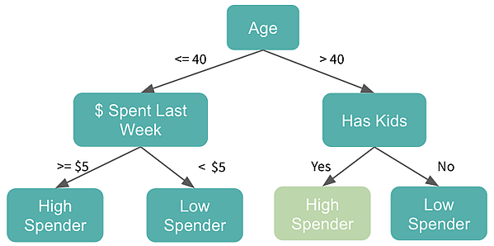
Decision Tree
Regression and Classification
Supervised or Unsupervised
Learns simple decision rules from the data
Rules are represented as nodes of a tree
Easy to interpret

Slide 3
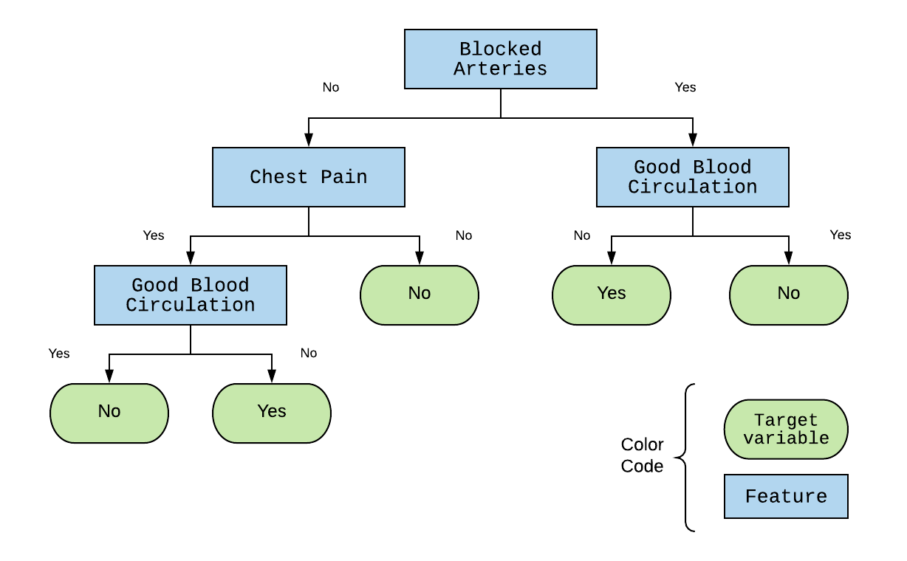
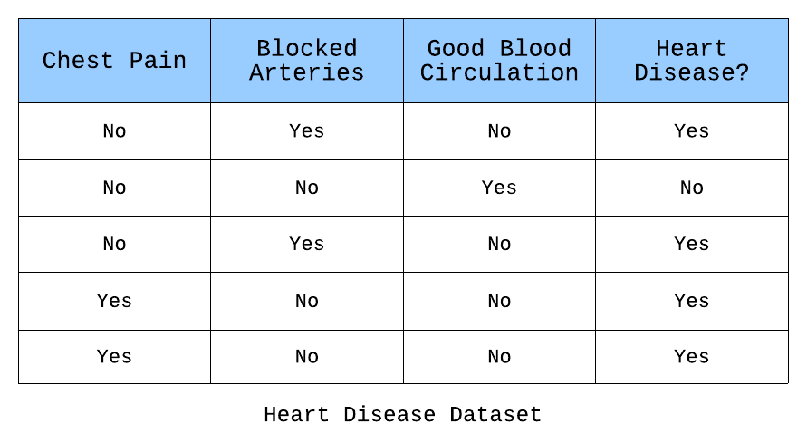

Slide 4
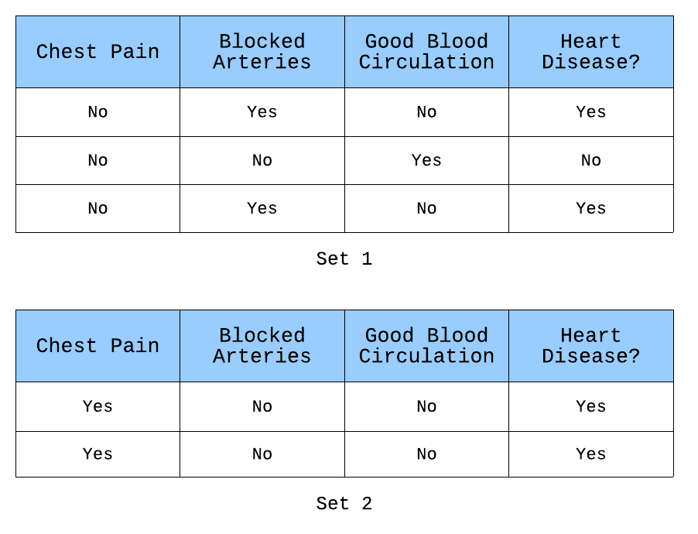
What is the best division?
Create two homogenous smaller datasets wrt the target variable.

Slide 5
Gini Impurity - Calculating homogeneity
Gini Impurity is the probability of classifying an observation incorrectly
Gini gain is the difference in impurity between a dataset and the subsets created after a split.

Slide 6
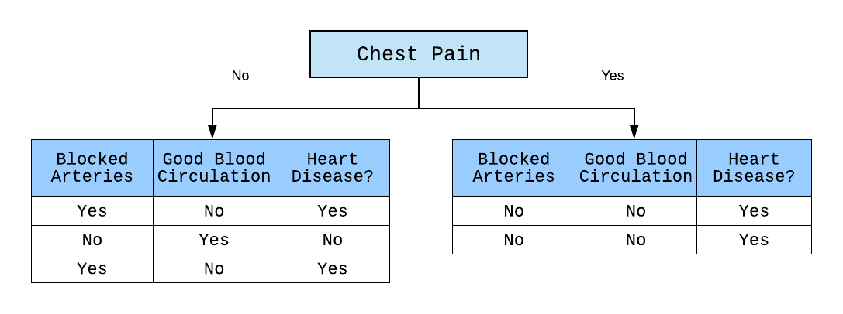
For each one of these subsets
Repeat entire division process

Slide 7
When do you stop construction ?
Maximum depth value
Gini gain decreases
Decrease means that the impurity is increasing.
Low number of instances in the subset

Slide 8
Ensemble Learning
Uses multiple predictors instead of the one
Wisdom of the crowd
Types
Bootstrap Aggregation (Bagging)
Pasting
Boosting
Stacking

Slide 9
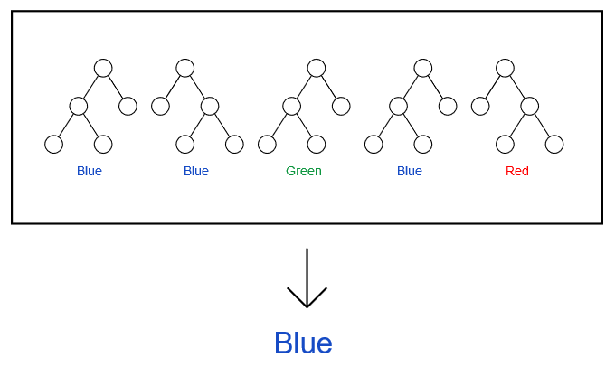
Random Forest
Uses multiple Decision Trees
Each tree will be different from the other in some way

Slide 10
Two Concepts
Bootstrapping
Bootstrap Aggregation

Slide 11
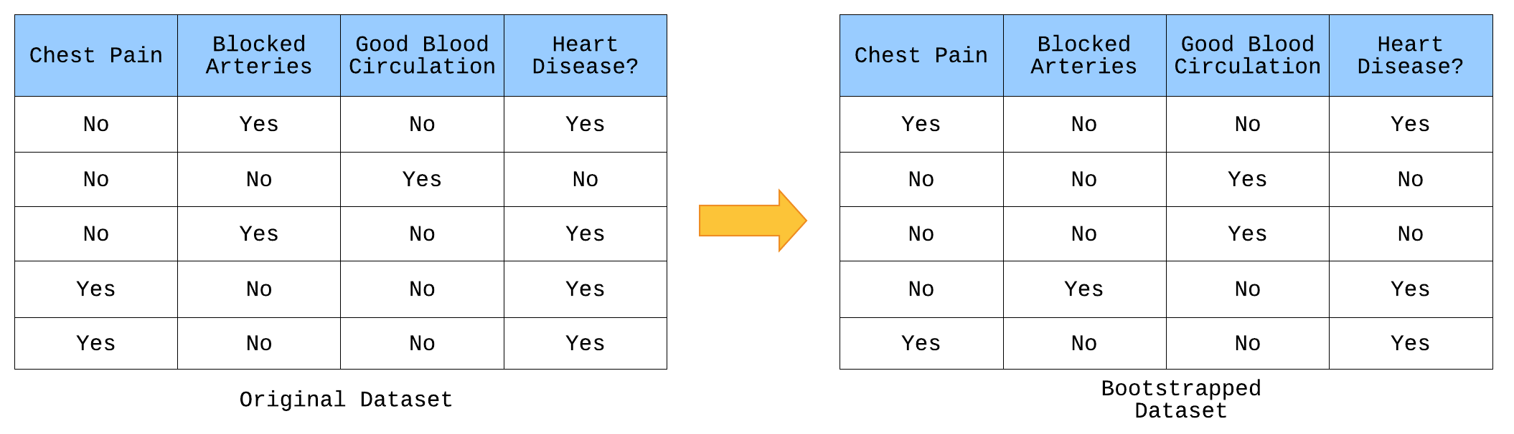
Bootstrapping
A way to create a new dataset based on an existing one
Pick any row with replacement

Slide 12
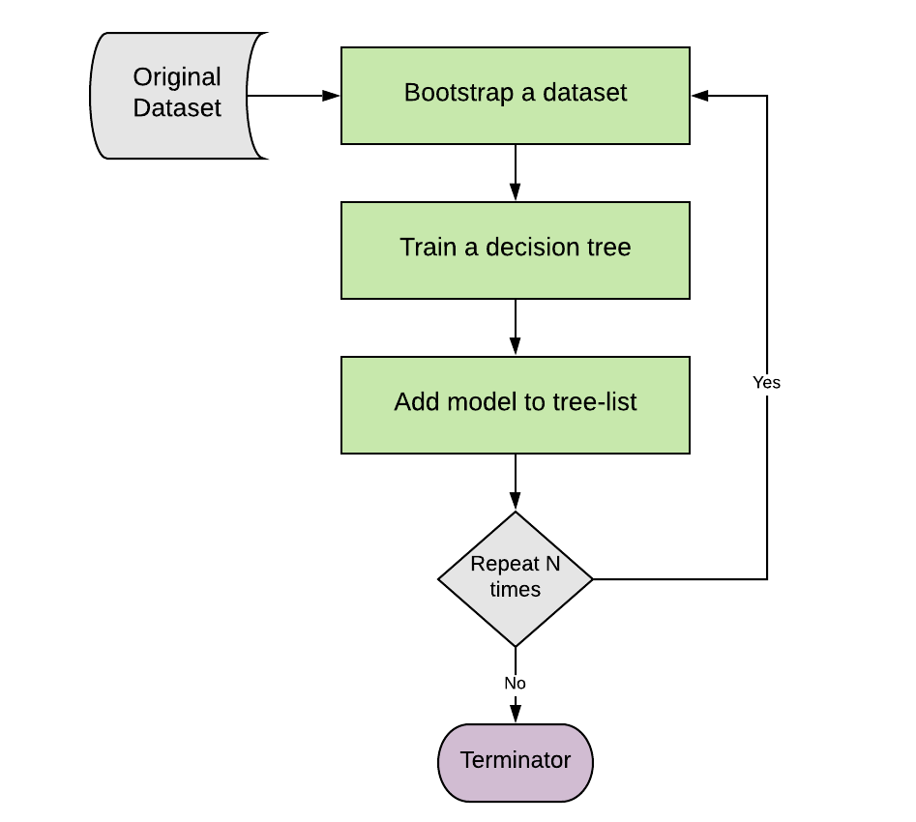
Bootstrap Aggregation
Algorithm to create multiple models of the same kind from a single training dataset

Slide 13
Making a prediction
Take the majority vote if the trees produce class labels
Take the average if the trees produce numerical values

Slide 14
Introducing Randomness in Decision Trees
Bootstrap Aggregation
Random Subspace method
Randomly drop attributes
Individual trees more unique
Reduces correlation between them
The variety makes the Random forest more effective than individual trees

